Slide 1

Data transfer and manipulation; Program control
Computer Organization and Architecture | Register Organization
Course: Computer Organization and Architecture | Chapter: Register Organization | Bachelor of Engineering
DISCOVER · LEARN · EMPOWER
Notes:
Welcome everyone to today's lecture on Data transfer and manipulation within the Register Organization chapter. We will explore how the CPU moves data and controls program flow. This session is designed to help you analyze the instruction set architecture effectively. Let us begin our journey into the heart of the processor.

Slide 2
Course Outcomes
SLIDE 2 / 10
Course Outcome
CO | BT LEVEL | DESCRIPTION
CO1 | BT3 | Apply number systems and digital logic to design basic digital circuits
CO2 | BT4 | Analyze register organization and instruction set architecture
CO3 | BT3 | Implement computer arithmetic algorithms and floating-point operations
CO4 | BT5 | Analyze memory hierarchy and input-output organization
CO5 | BT6 | Evaluate control unit design and pipelining performance
Chandigarh University
2 / 10
Notes:
Today's lecture directly addresses Course Outcome 2, which requires you to analyze register organization and instruction set architecture. We will focus specifically on how data moves between registers and how program control instructions alter the execution sequence. By the end of this session, you will be able to trace these operations on a sample instruction set.

Slide 3
Learning Objectives
SLIDE 3 / 10
Learning Outcomes
1
Analyze the mechanisms of data transfer between registers and memory.
2
Evaluate the role of arithmetic and logic operations in data manipulation.
3
Differentiate between various program control instructions like jumps and calls.
4
Apply register organization concepts to trace a simple program execution flow.
5
Assess the impact of data transfer on overall system performance.
Chandigarh University
3 / 10
Notes:
By the end of this lecture, you will be able to analyze how data moves between registers and memory. You will evaluate how arithmetic and logic operations manipulate this data. We will also differentiate between jump and call instructions to understand program control. Finally, you will apply these concepts to trace a simple program execution flow.

Slide 4
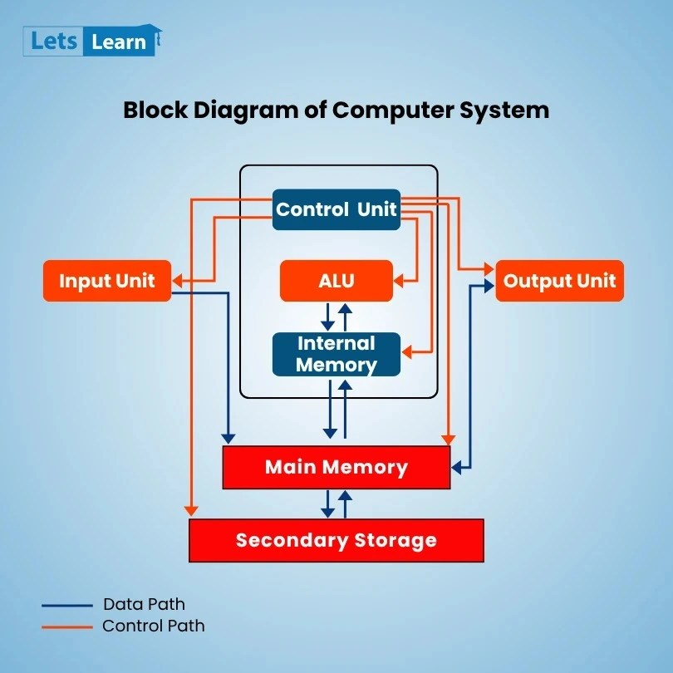
Lecture
SLIDE 4 / 10
Data Transfer Mechanisms
1
Data transfer moves information between registers, memory, and I/O devices.
2
Register-to-register transfer is the fastest operation in the CPU.
3
Memory-to-register transfer involves fetching data from main memory address.
4
Register-to-memory transfer stores the result of an operation back.
5
I/O transfer moves data between the processor and peripheral devices.
Block Diagram of Computer System with Components
Chandigarh University
4 / 10
Notes:
Data transfer is the fundamental operation that moves information between different parts of the computer. Register-to-register transfer is the fastest because it happens entirely within the CPU. For example, moving data from register R1 to R2 takes only one clock cycle. Memory transfers are slower because they involve the external bus and address decoding.

Slide 5
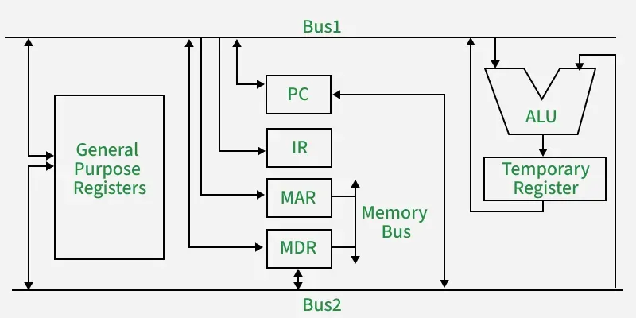
Lecture
SLIDE 5 / 10
Data Manipulation Operations
1
Arithmetic operations include addition, subtraction, multiplication, and division.
2
Logic operations include AND, OR, NOT, XOR, and shift operations.
3
Shift operations move bits left or right to multiply or divide by powers of two.
4
The ALU performs all data manipulation tasks using the control signals.
5
Results of operations are typically stored back into a destination register.
Source: media.geeksforgeeks.org
Chandigarh University
5 / 10
Notes:
Data manipulation involves arithmetic and logic operations performed by the Arithmetic Logic Unit. Shift operations are particularly efficient for multiplying or dividing by powers of two. For instance, a logical left shift of the binary number 0010 results in 0100, effectively doubling the value. These operations are essential for executing complex algorithms within the processor.

Slide 6
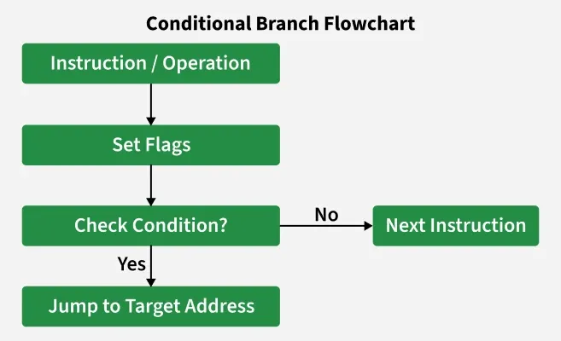
Lecture
SLIDE 6 / 10
Program Control Instructions
1
Program control instructions alter the sequence of instruction execution.
2
Unconditional jumps change the program counter to a new address immediately.
3
Conditional jumps execute only if specific status flags meet certain conditions.
4
Subroutine calls save the return address before jumping to a function.
5
Return instructions restore the program counter to continue execution after a call.
Source: media.geeksforgeeks.org
Chandigarh University
6 / 10
Notes:
Program control instructions allow the CPU to make decisions and repeat tasks. Unconditional jumps always change the program counter to a new address. Conditional jumps, like 'Jump if Zero', only execute if the status flags indicate a specific condition. For example, a loop in a program relies on conditional jumps to repeat a block of code until a counter reaches zero.

Slide 7
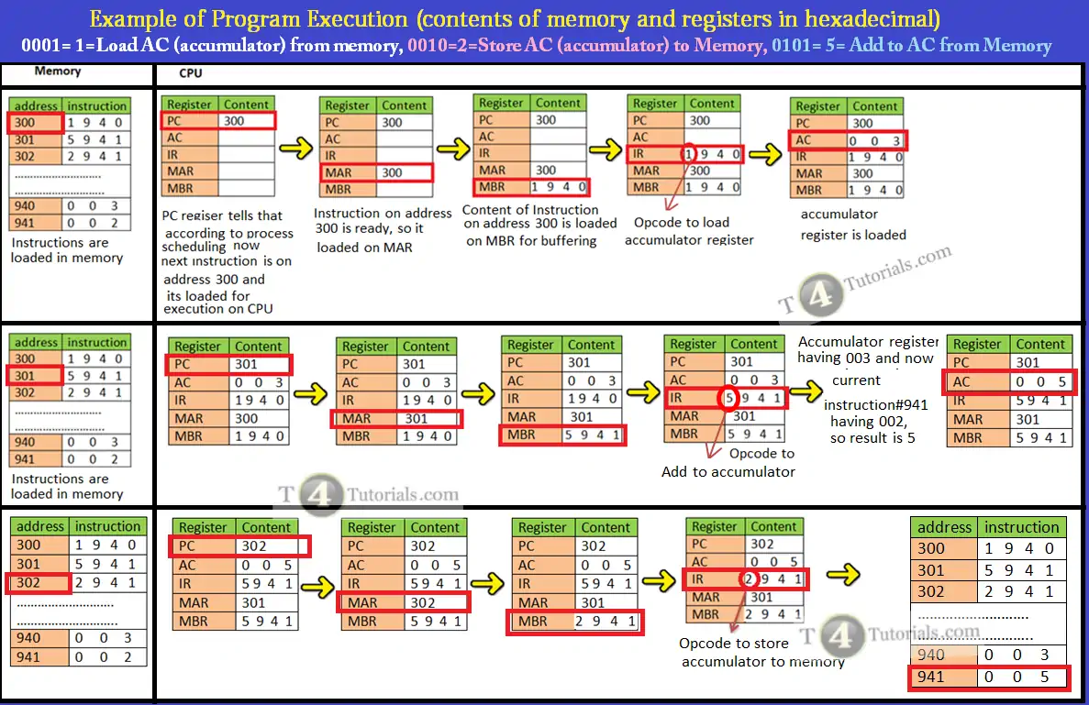
Worked Example
SLIDE 7 / 10
Data Transfer
GOVERNING EQUATION
Initial state: Register R1 = 0010 (decimal 2), Register R2 = 0101 (decimal 5)
INSTRUCTION
ADD R1, R2 (Add contents of R2 to R1).
OPERATION
R1 = R1 + R2 = 2 + 5 = 7.
RESULT
Register R1 now holds the binary value 0111 (decimal 7).
• This demonstrates how data is manipulated and stored in a single cycle.
Source: t4tutorials.com
Chandigarh University
7 / 10
Notes:
Let's trace a simple data manipulation example to see how registers work. Initially, R1 holds the value 2 and R2 holds the value 5. When we execute the ADD instruction, the ALU adds these values. The result, 7, is stored back into R1. This single operation demonstrates the speed and efficiency of register-based data manipulation.

Slide 8
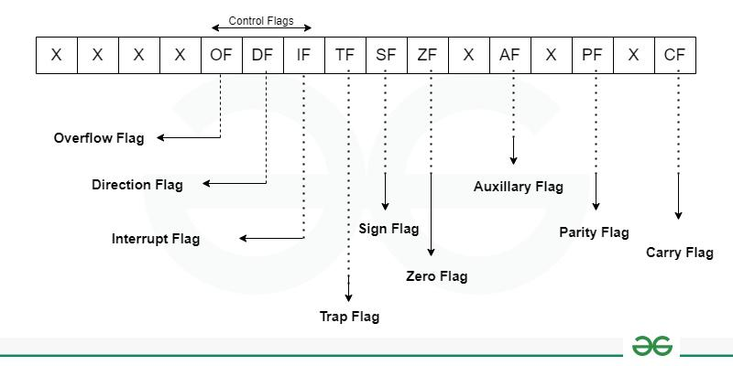
Worked Example
SLIDE 8 / 10
Program Control
GOVERNING EQUATION
Initial state: Program Counter (PC) = 100, Status Flag Z = 0
INSTRUCTION
JZ Label (Jump if Zero to Label).
CONDITION CHECK
Since Z is 0 (not zero), the jump is NOT taken.
NEXT STEP
PC increments to 101 to fetch the next instruction.
• If Z were 1, PC would load the address of Label instead.
Source: media.geeksforgeeks.org
Chandigarh University
8 / 10
Notes:
Now let's look at program control with a conditional jump. If the Program Counter is at 100 and the Zero flag is 0, the jump instruction is ignored. The CPU simply moves to the next address, 101. However, if the Zero flag were 1, the PC would jump to a specific label address. This mechanism allows the processor to implement loops and decision-making logic.

Slide 9
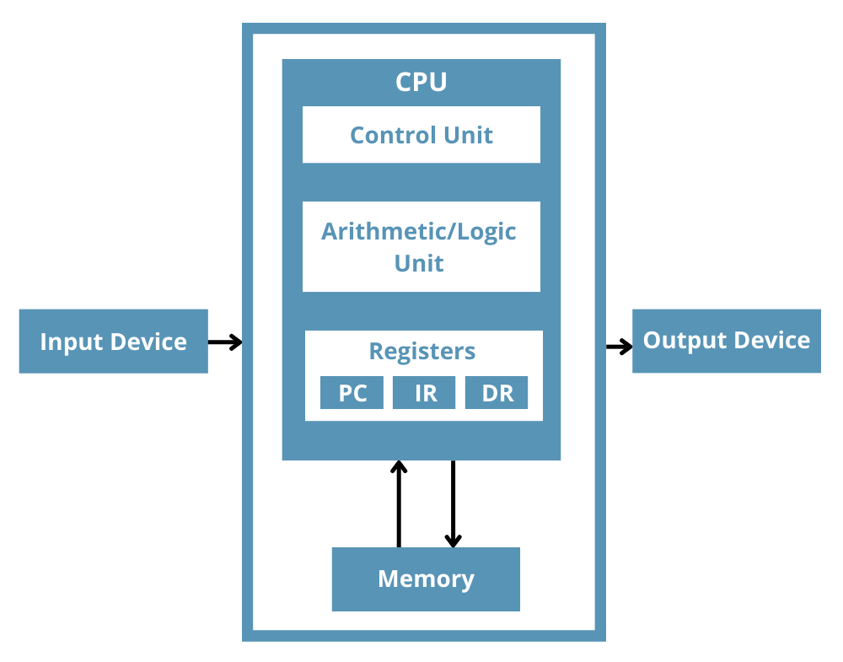
Lecture
SLIDE 9 / 10
Key Takeaways
1
Data transfer moves information between registers, memory, and I/O devices efficiently.
2
Arithmetic and logic operations manipulate data within the ALU using registers.
3
Program control instructions modify the program counter to alter execution flow.
4
Conditional jumps depend on status flags to decide whether to branch.
5
Understanding these operations is crucial for analyzing instruction set architecture.
Source: www.totalphase.com
Chandigarh University
9 / 10
Notes:
To summarize, data transfer moves information between different components of the computer system. Arithmetic and logic operations manipulate this data within the ALU. Program control instructions are vital for altering the execution flow based on conditions. Understanding these operations is essential for analyzing the instruction set architecture effectively.

Slide 10
Lecture
SLIDE 10 / 10
References
COMPUTER ORGANIZATION AND DESIGN
The Hardware/Software Interface — David A. Patterson, John L. Hennessy
COMPUTER ARCHITECTURE
A Quantitative Approach — John L. Hennessy, David A. Patterson
• Computer Organization and Architecture — William Stallings
• Computer System Architecture — M. Morris Mano & Rajib Mall
• Computer Organization — Carl Hamacher, Zvonko Vranesic, Safwat Zaky
Chandigarh University
10 / 10
Notes:
For further reading, I recommend the textbooks listed on this slide. William Stallings and M. Morris Mano provide excellent foundational knowledge. David A. Patterson and John L. Hennessy offer deep insights into modern architecture. Carl Hamacher's work is also highly recommended for detailed technical understanding. Please refer to these books for more complex examples and exercises.

